Slide 1
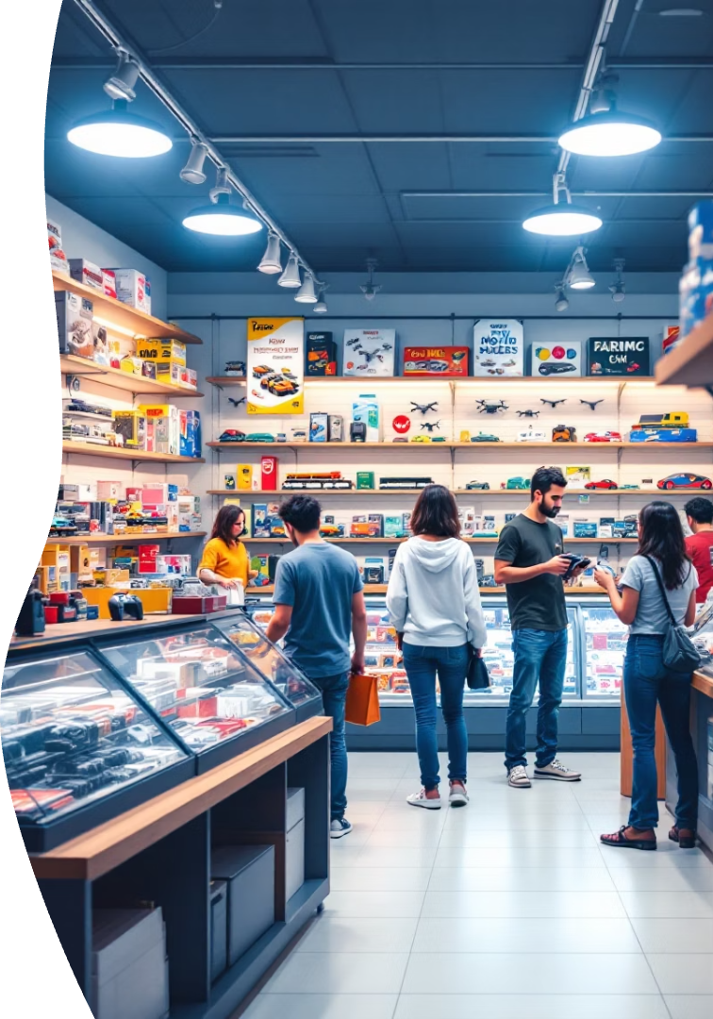
Personalized Product Recommendation System
Enhancing the Horizon Hobby customer experience through intelligent product recommendations

Slide 2
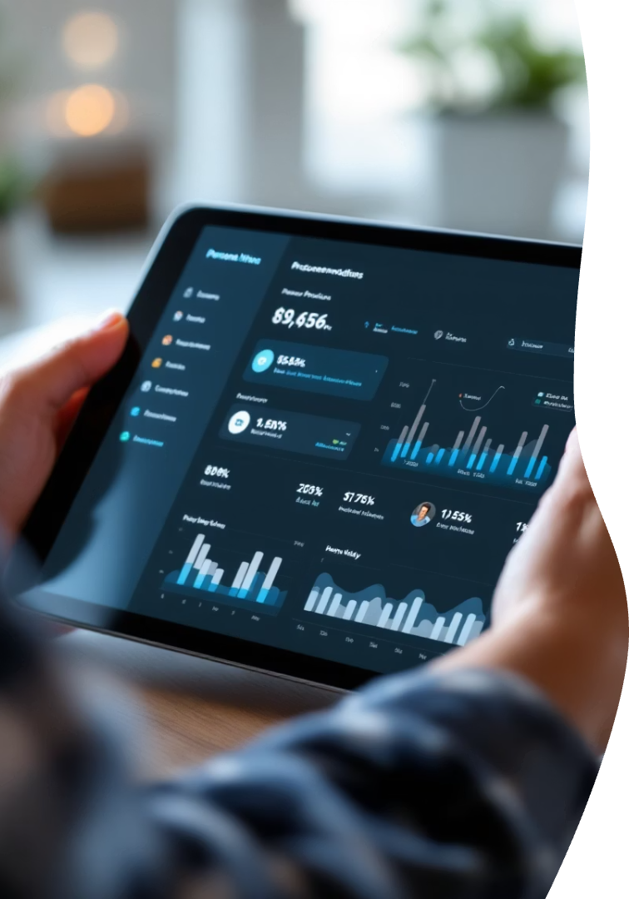




Project Overview
Deliver personalized recommendations
Boost conversion rates
Match customers with relevant products from diverse catalog
Turn browsers into buyers with targeted suggestions
Improve customer retention
Keep hobbyists engaged with relevant discoveries

Slide 3






Business Context
Customer loyalty
Creates brand advocates
Sales uplift
Drives revenue growth
Personalized discovery
Guides users through extensive catalog

Slide 4








Dataset Schema
Fact Table: Transactions
Dimension: Customers
Central repository of all sales data
Demographic and loyalty information
Dimension: Dates
Dimension: Products
Temporal attributes for trend analysis
Category, brand, and availability details

Slide 5
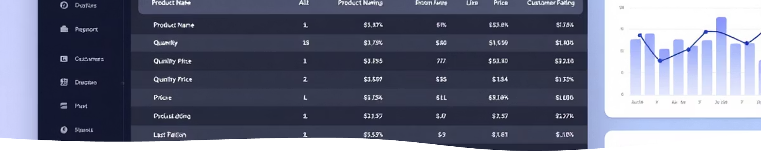
Dataset Details
Table
Key Fields
fact_transactions
transaction_id, customer_id, product_id, quantity, price
dim_customers
demographics, loyalty status
dim_products
category, brand, availability
dim_promotions
promo type, duration, segment

Slide 6

Additional Tables
Promotion Mapping
Age Breakout
Links promotions to applicable products
Segments customers by age range
Enables promotional targeting analysis
Reveals generational preference patterns
Gender Breakout
Groups customers by gender identity
Identifies category preference trends

Slide 7
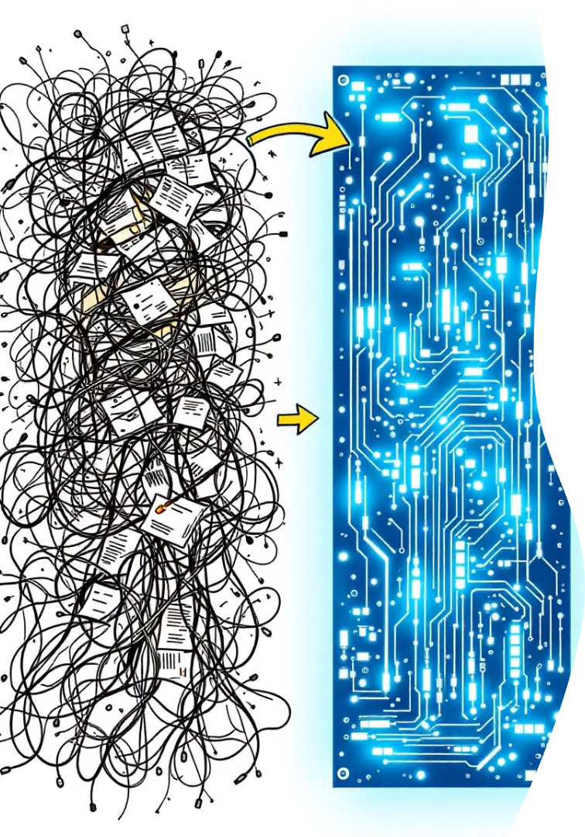
Data Cleaning
Standardize Formats
Consistent column naming conventions
Uniform data types across tables
Date Conversion
String dates transformed to datetime objects
Enables temporal analysis features
Handle Missing Values
"Unknown" for categorical nulls
Statistical imputation for numerics

Slide 8
Feature Engineering
Temporal Features
Customer Metrics
Loyalty Segments
Month extraction
Days since first purchase
New: 0-30 days
Day of week
Activity timespan
Medium: 31-180 days
Weekend flag
Purchase frequency
Loyal: >180 days

Slide 9
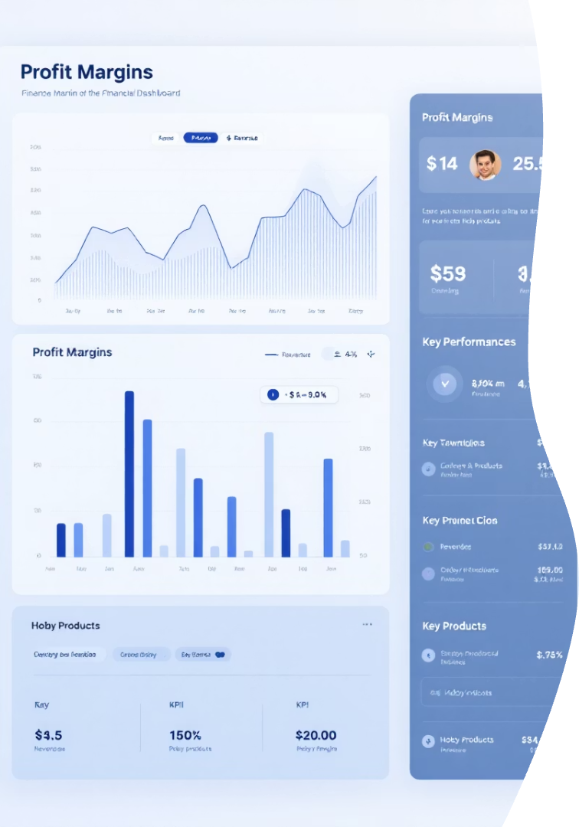



Financial Features
Revenue per Quantity
Total sales value divided by units sold
Profit
Revenue minus cost calculation
Profit Margin
Percentage of revenue retained as profit

Slide 10
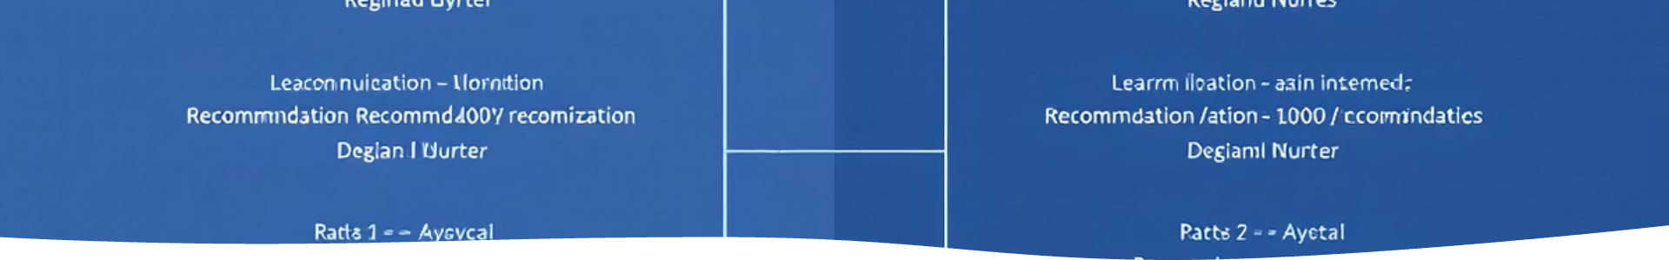




Modeling Techniques
Baseline Models
Global and segment popularity rankings
Collaborative Filtering
ALS matrix factorization with implicit feedback
Content-Based
User-product feature similarity matching
Hybrid Model
Combined approach leveraging multiple techniques

Slide 11
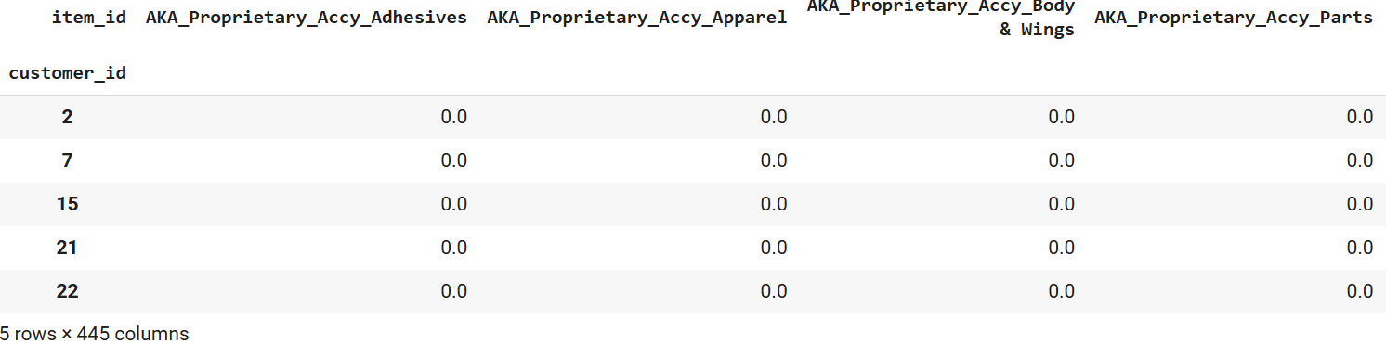
User-item matrix

Slide 12
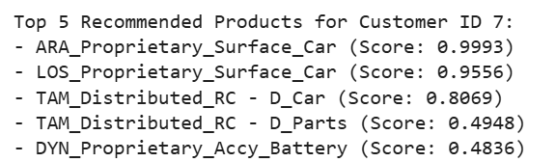
ALS Matrix factorization

Slide 13
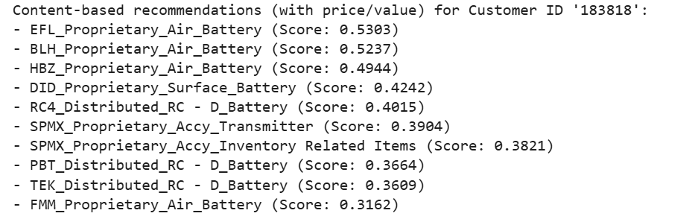
Content based recommendation

Slide 14



Hybrid System Architecture
Business Filters
In-stock, high-margin, promotion-active
Hybrid Predictions
Combined collaborative & content-based models
Input Data
Transaction history, promotions, loyalty tier

Slide 15
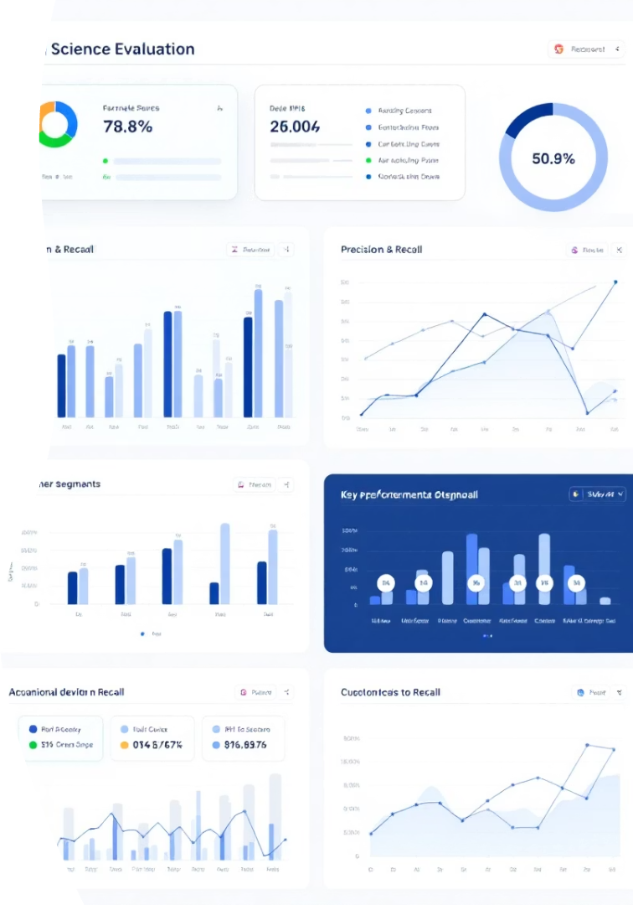
Evaluation Strategy
Temporal Split
Last N weeks reserved for testing
Key Metrics
Precision@10, Recall@10, NDCG
Segmented Analysis
Performance across different customer groups

Slide 16






Segment-wise Analysis
Promotion Impact
Active vs. inactive campaigns
Loyalty Segments
New vs. Loyal users
Product Categories
High-traffic vs. niche items

Slide 17






Deployment Readiness
API Integration
Schema ready for frontend consumption
Batch Scoring Pipeline
Regular refresh of recommendations
Business Filters
Available items, promotions, margins

Slide 18


Key Insights
Feature Engineering
Massive uplift in relevance
Star Schema
2
Clear, scalable data modeling
Hybrid System
3
Most consistent performer
Contextual Signals
Loyalty and promotions drive results

